Slide 1
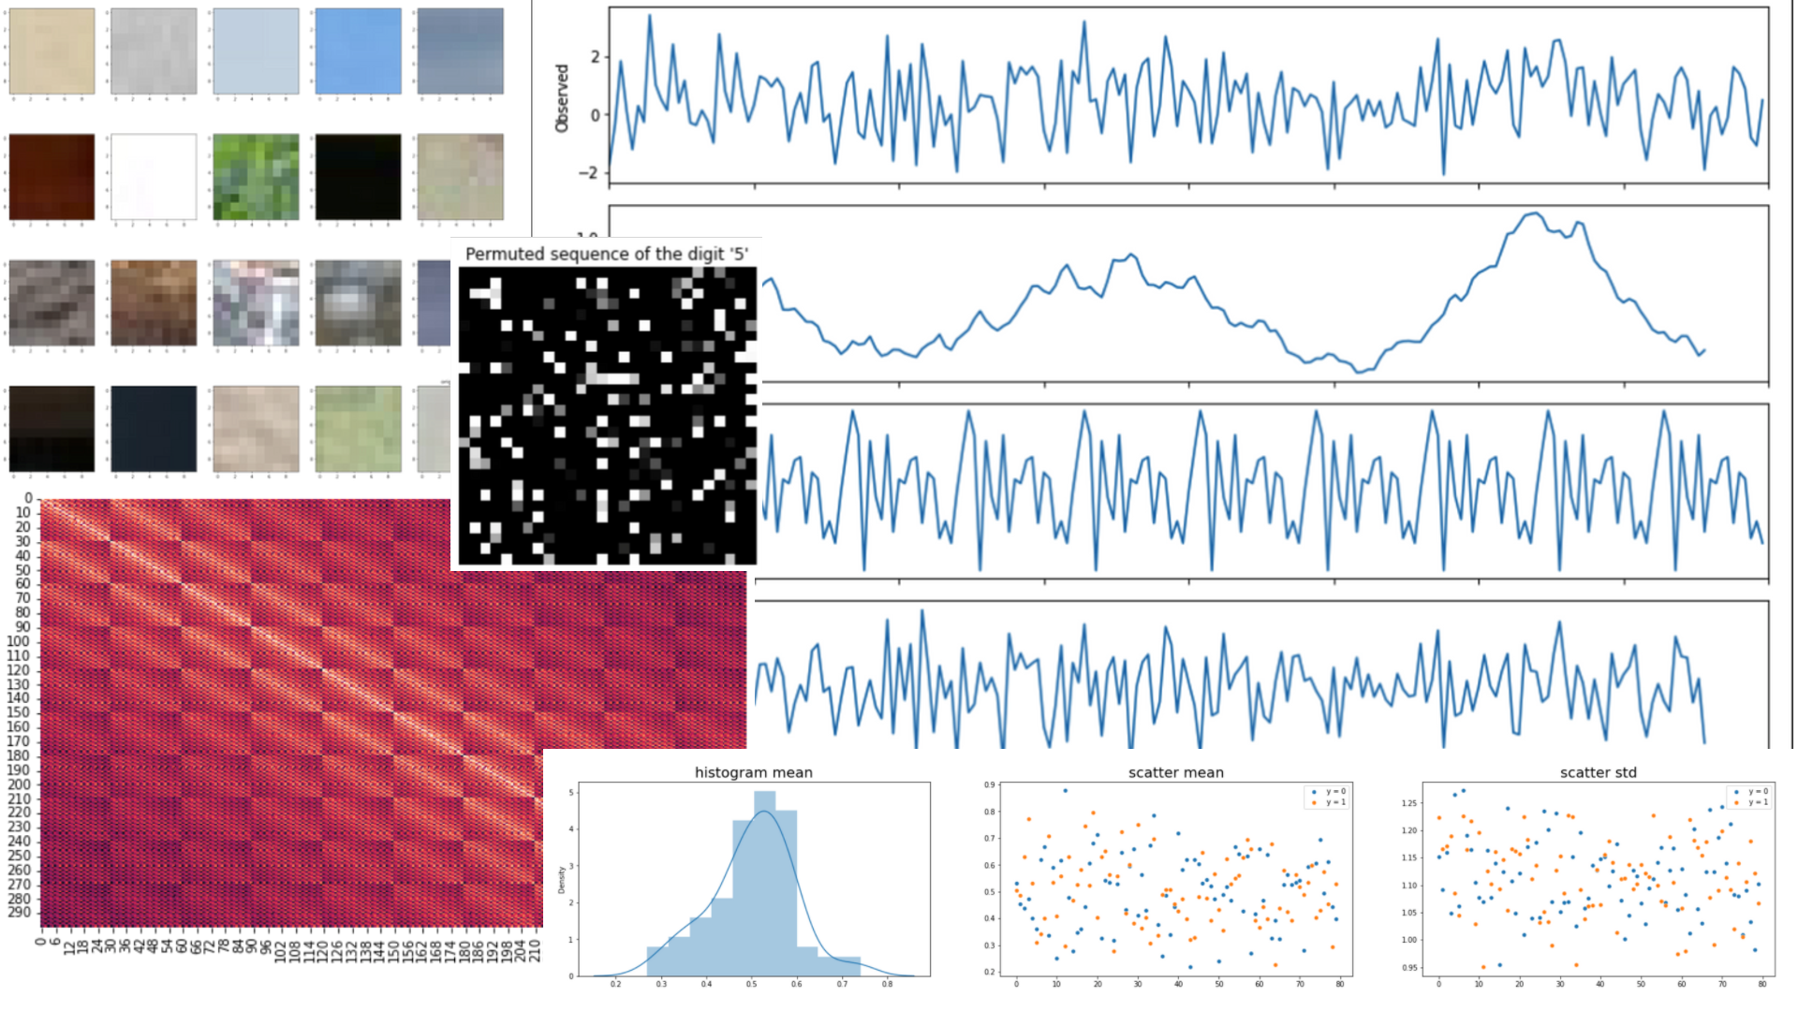

AIN6020
What am I looking at ?
Team 4 : Jinsoo Kim, Sunghyun Hwang, Myeongsoo Han,
Byeongtae Park, Eunseon Seong, Harim Lee

Slide 2
Dataset 1
Exploration Data Analysis
Modeling
Result
Appendix

Slide 3
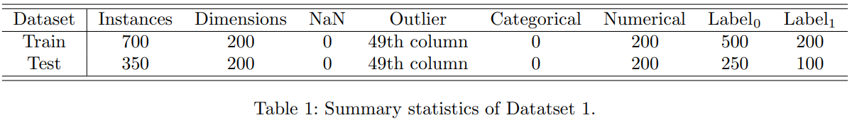
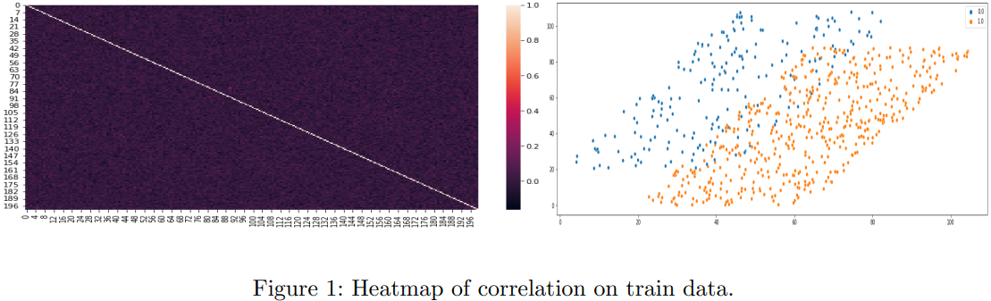
01
Exploration Data Analysis
‹#›

Slide 4
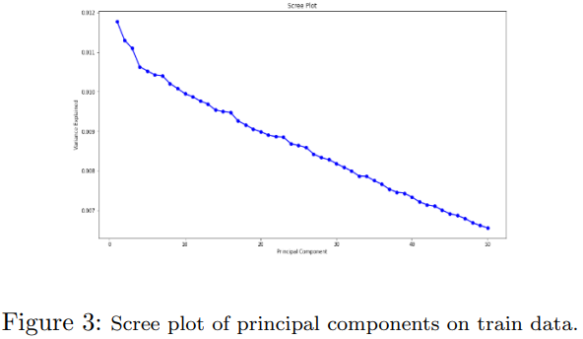
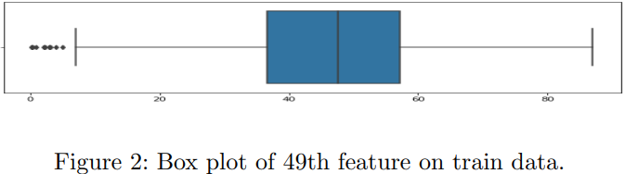
01
Exploration Data Analysis
‹#›

Slide 5
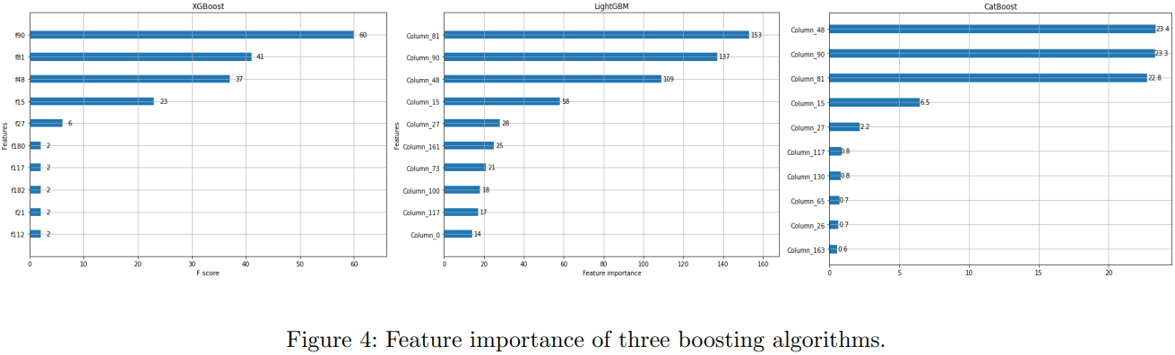
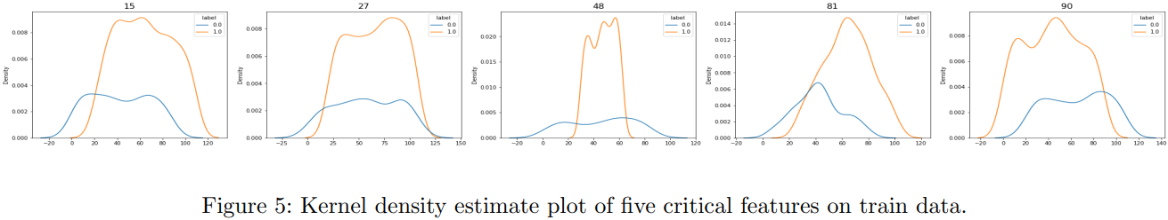
02
Modeling
‹#›

Slide 6
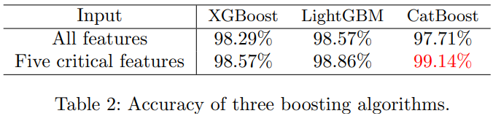
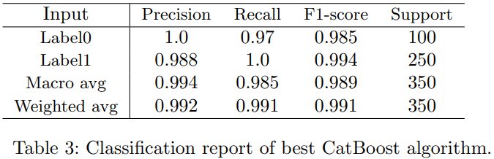
03
Result
‹#›

Slide 7
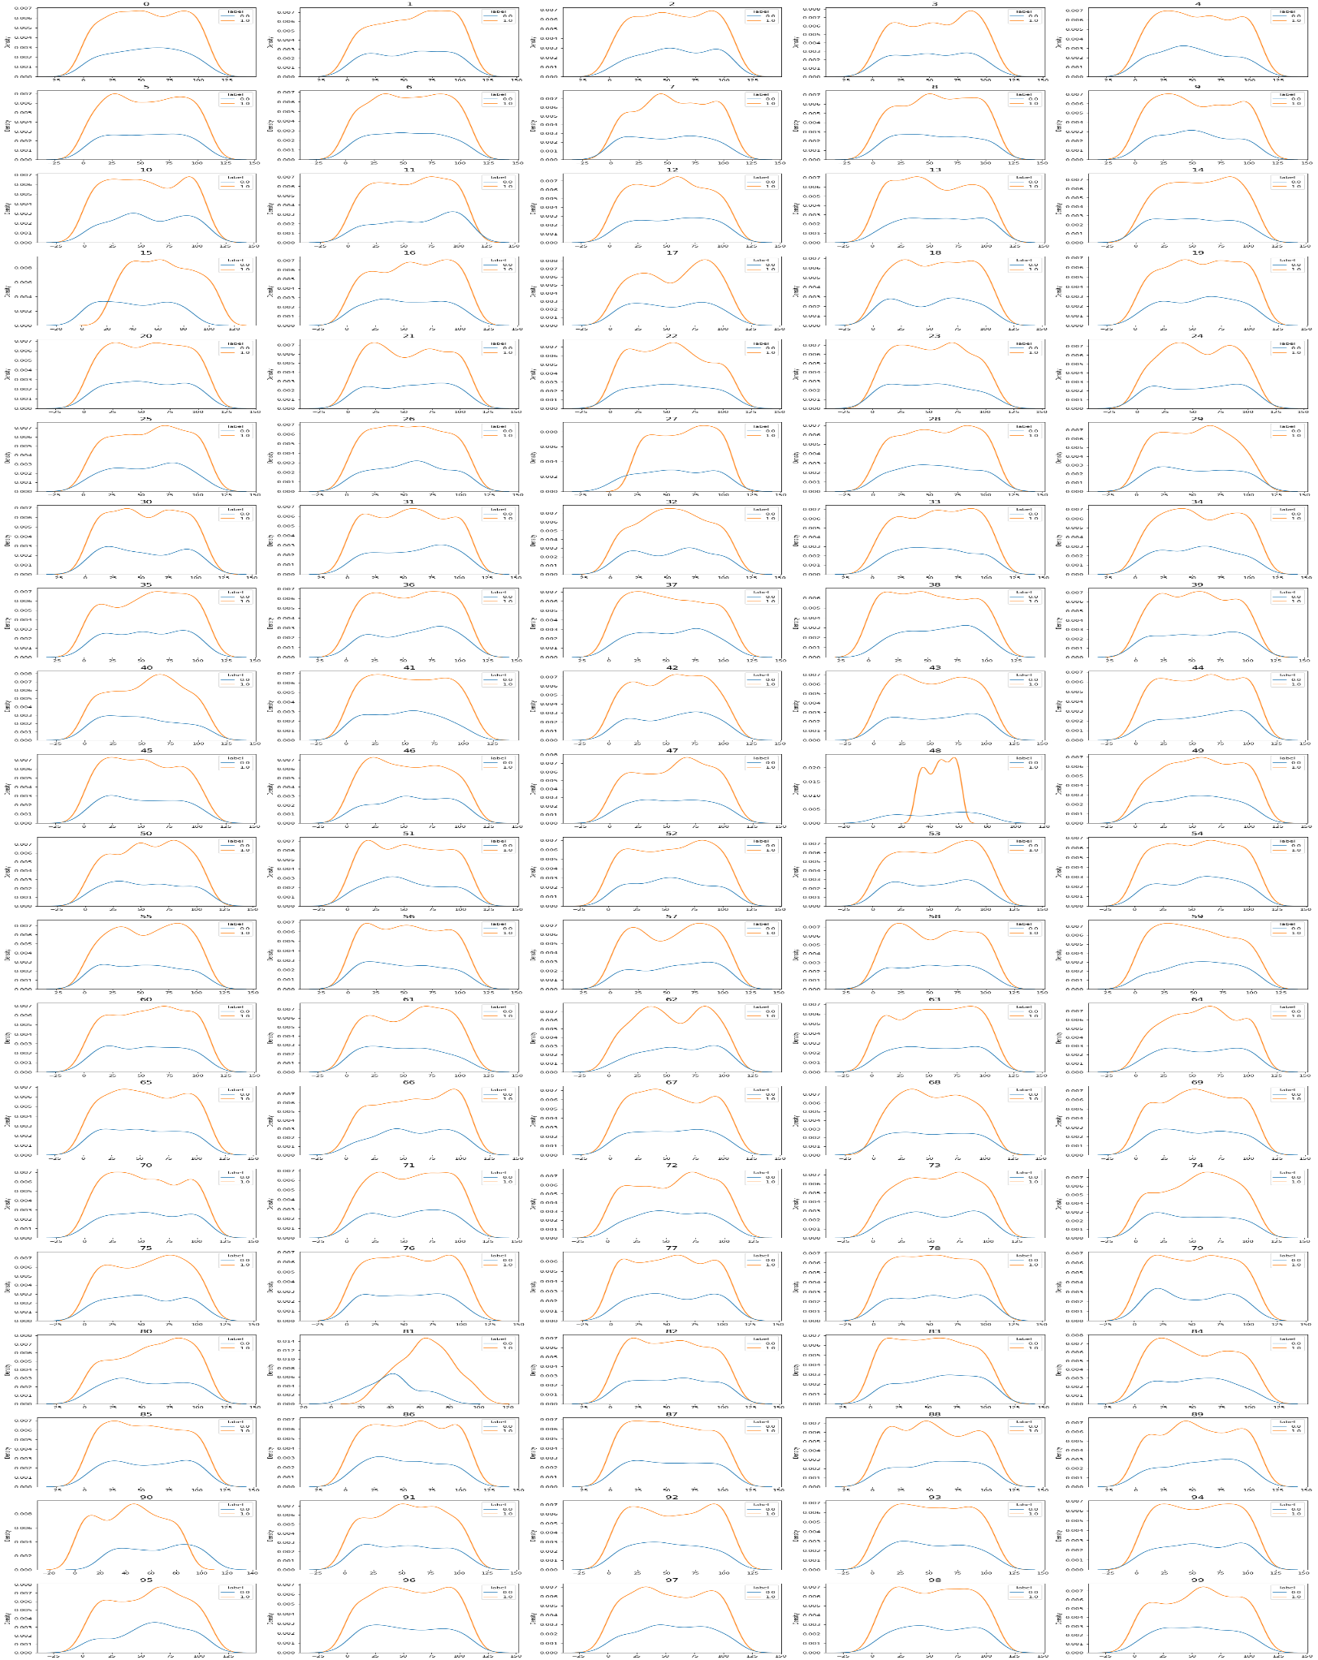
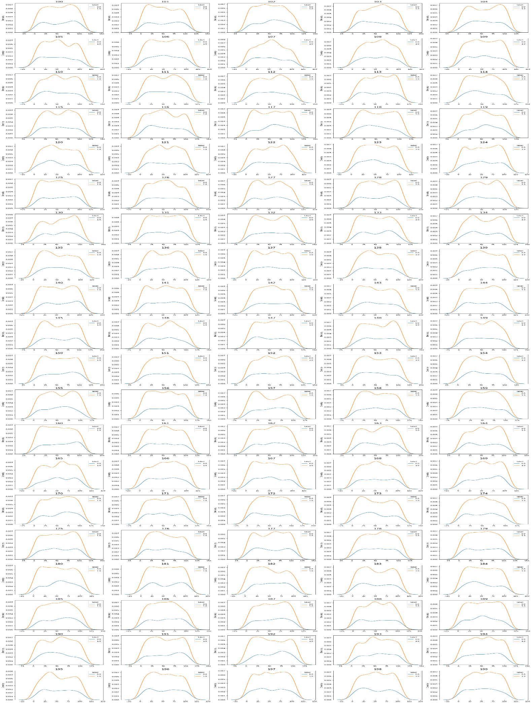
04
Appendix
‹#›

Slide 8
Dataset 2

Slide 9
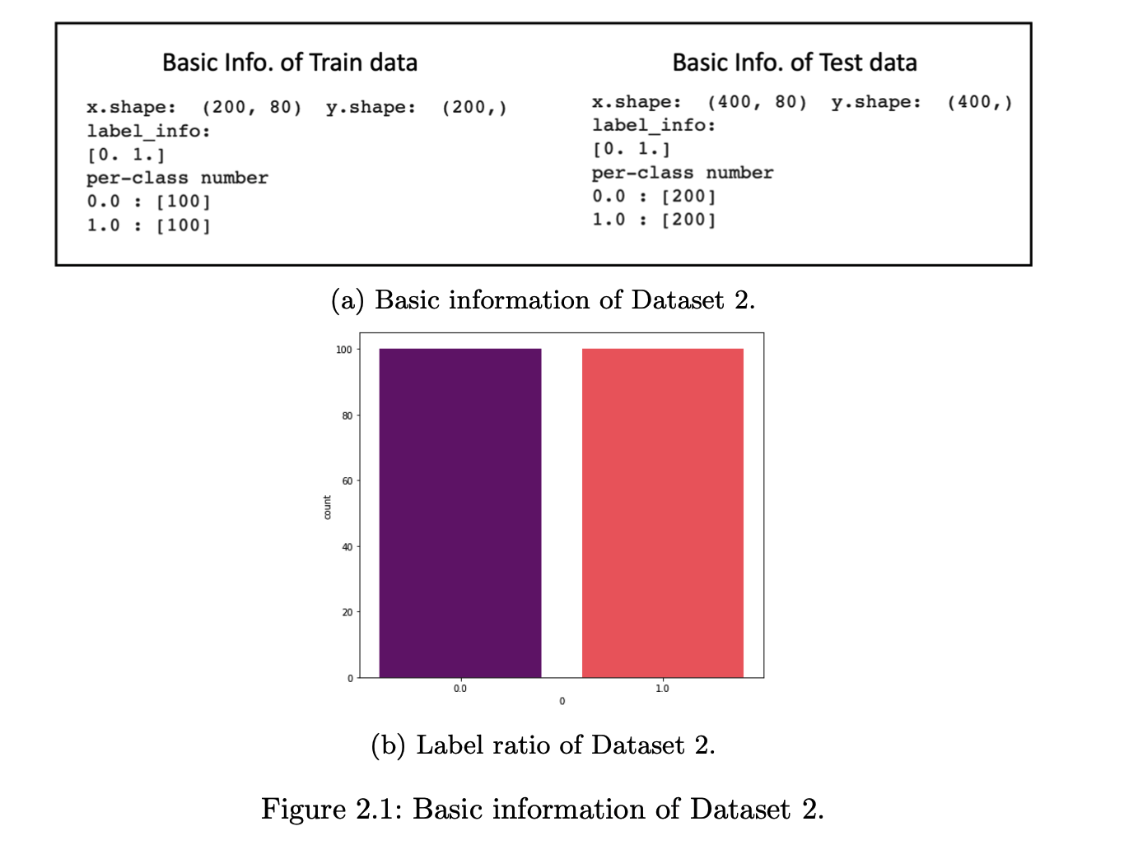
Data Description
Binary classification with balanced label
‹#›

Slide 10
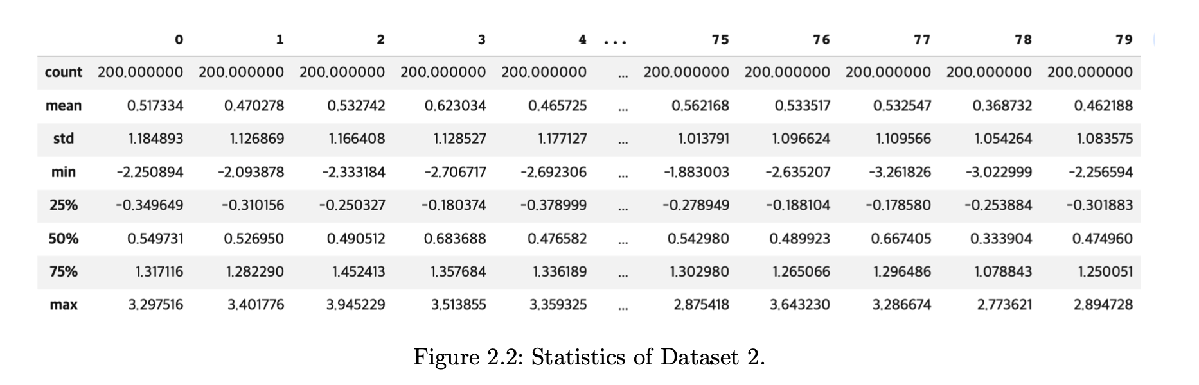
Data Description
Statistics
‹#›

Slide 11
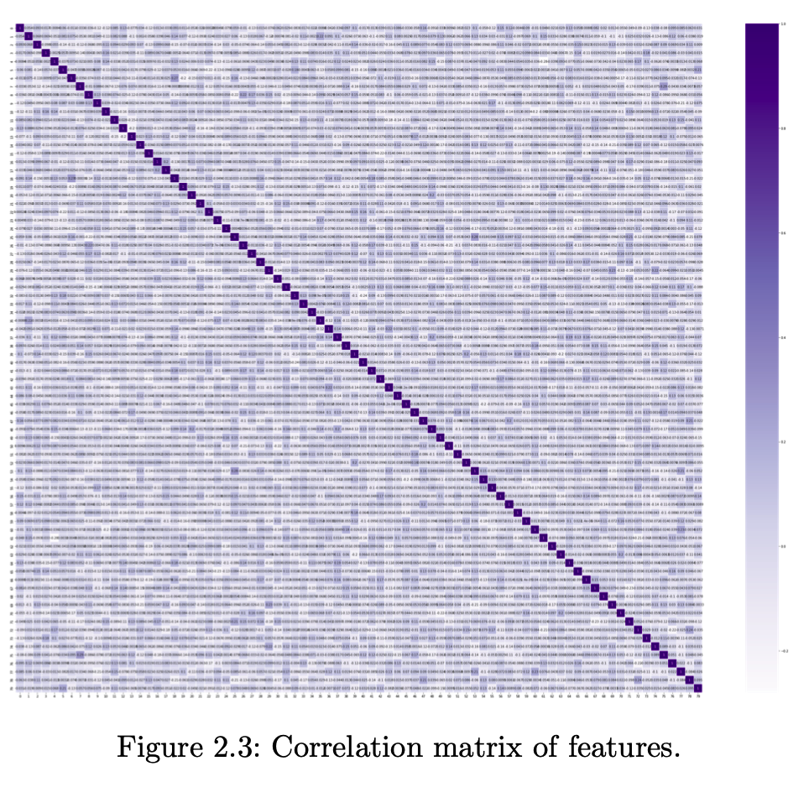
Exploration Data Analysis
Correlation Plot
There are not any special correlations
between features
‹#›

Slide 12
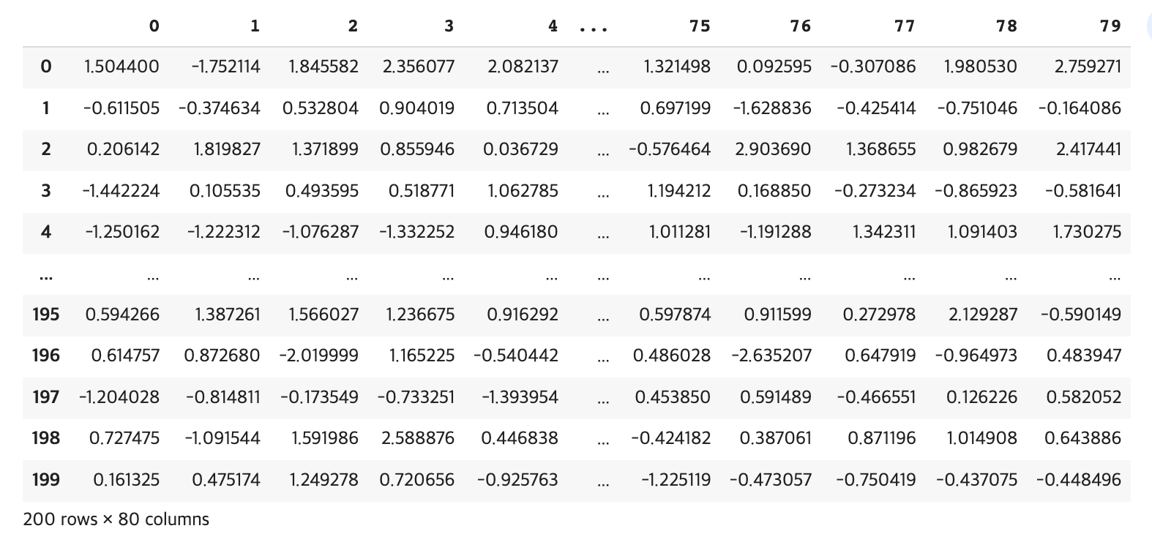
Exploration Data Analysis
Time Series Decomposition
80 features
It may be Tabular Timeseries Data!
200 time-stemp
‹#›

Slide 13
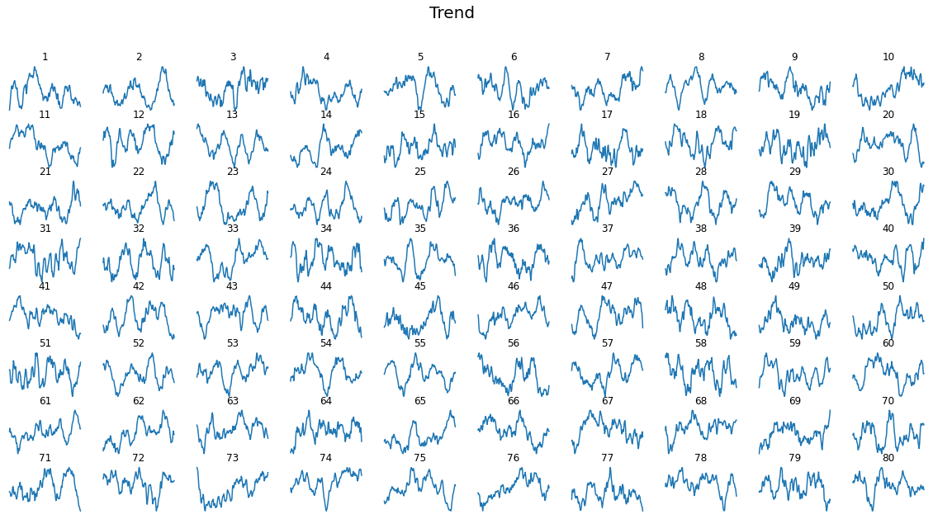
Exploration Data Analysis
Time Series Decomposition - Trend, Seasonal, Residual
‹#›

Slide 14
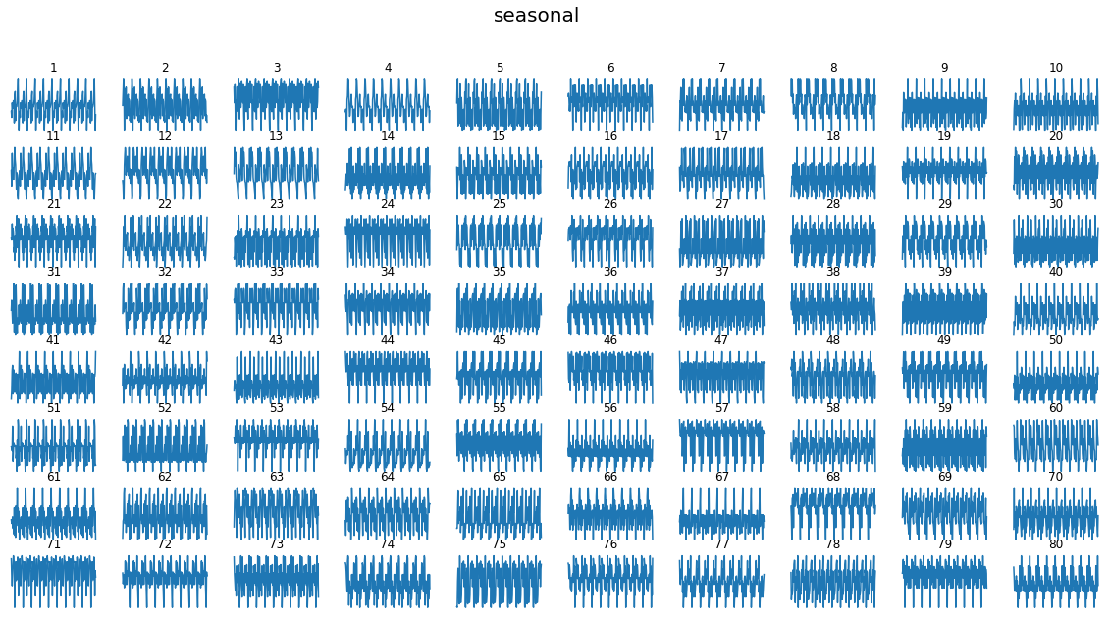
Exploration Data Analysis
Time Series Decomposition - Trend, Seasonal, Residual
‹#›

Slide 15
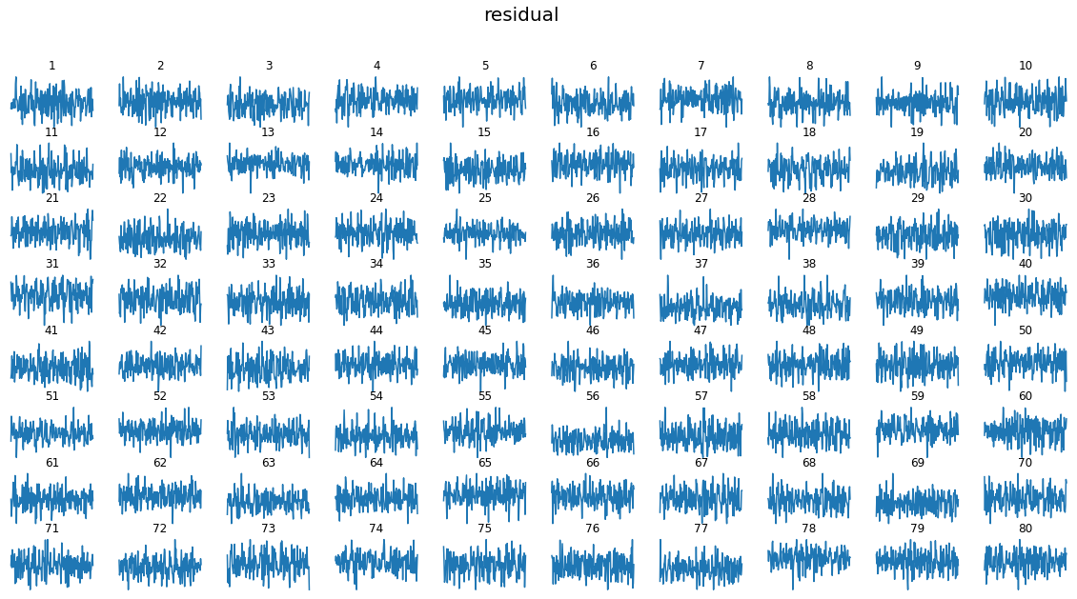
Exploration Data Analysis
Time Series Decomposition - Trend, Seasonal, Residual
‹#›

Slide 16
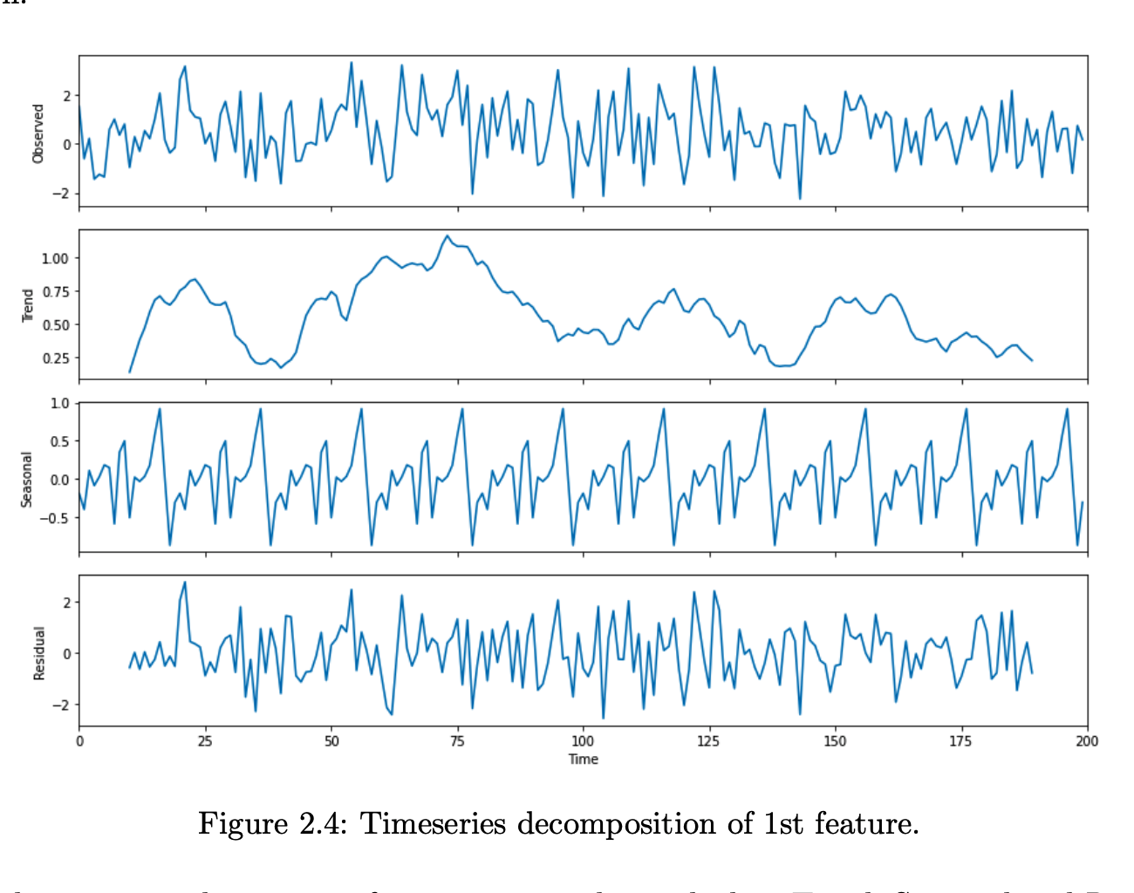
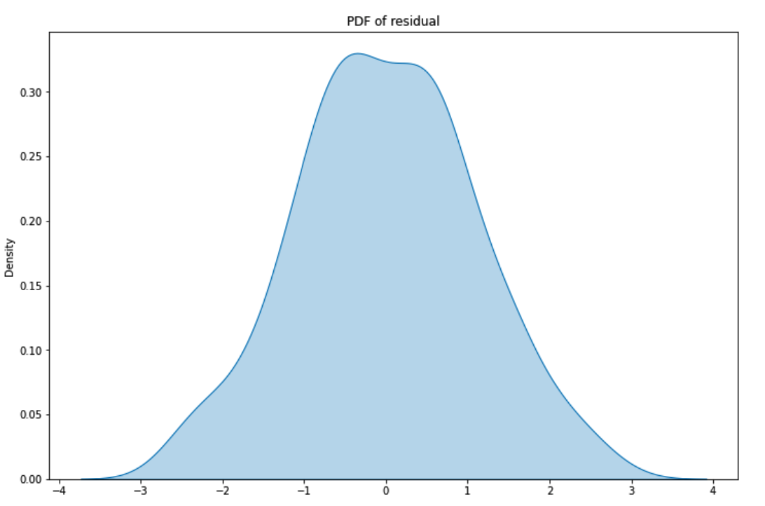
Exploration Data Analysis
Time Series Decomposition on 1st feature
PDF of Residual
gaussian / no special outliers
‹#›

Slide 17
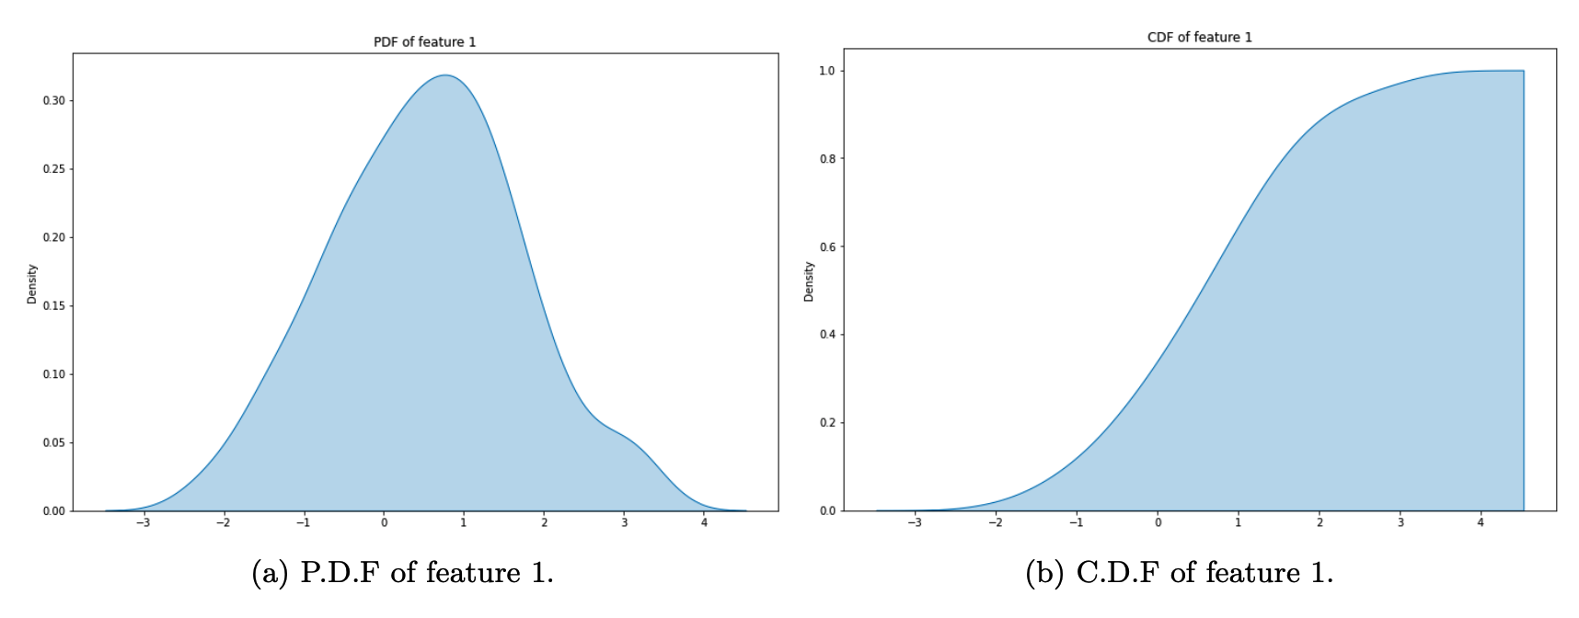
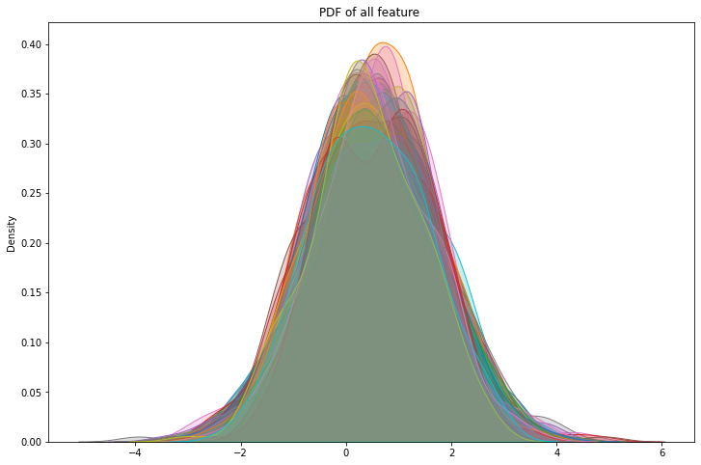
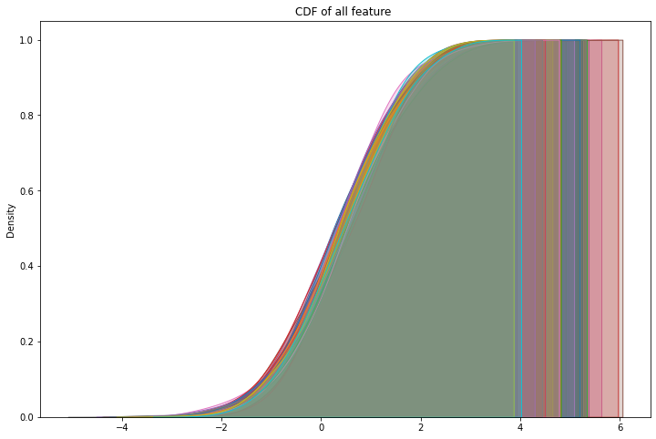
Exploration Data Analysis
PDF & CDF of all 80 features; Arbitrary Gaussian?
Feature 1
‹#›

Slide 18
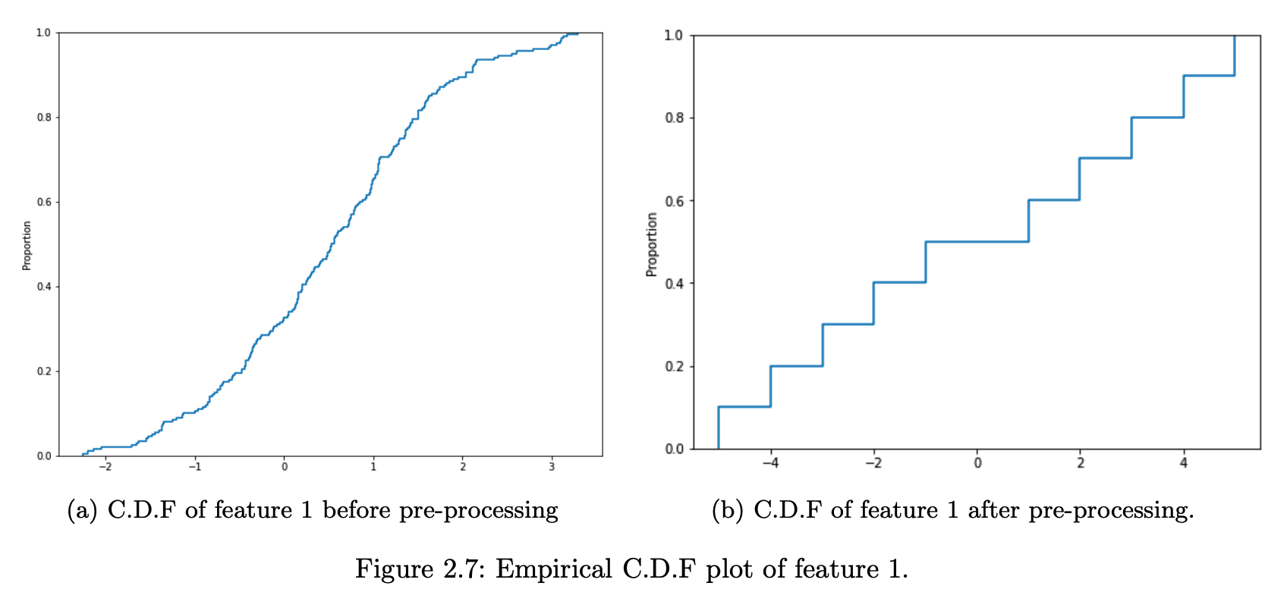
Preprocessing
Feature Quantization & Rescaling
10%
‹#›

Slide 19
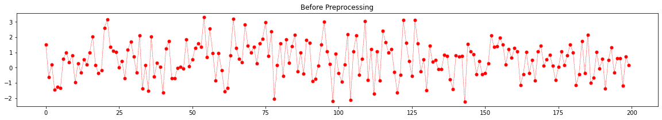
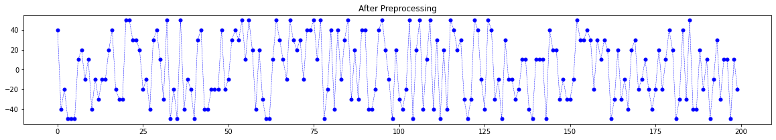
Preprocessing
Feature Quantization & Rescaling
‹#›

Slide 20
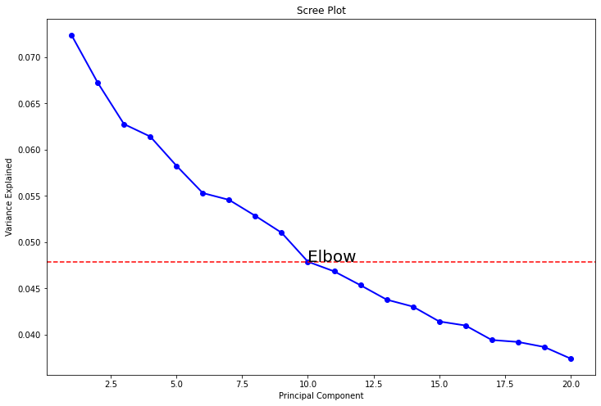
Modeling
Principle Component Analysis
Model input
10 PCs
+
preprocessed data
Kernel SVM with
polynomial kernel
‹#›

Slide 21
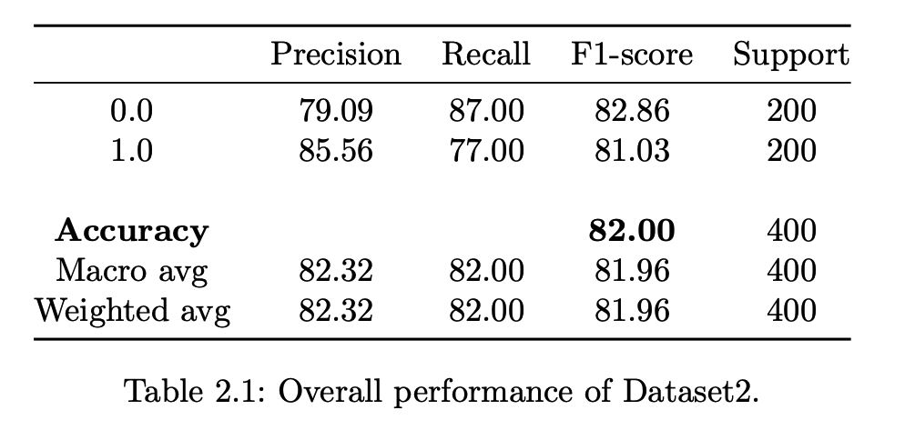
Result
Achieve 82.0% accuracy with test data
Follow parameters of NuSVC gives the best performance :
{nu = 0.64,
gamma = 'scale’,
coef0 = 0.075,
kernel = 'poly’,
degree = 3}.
‹#›

Slide 22
Dataset 3

Slide 23
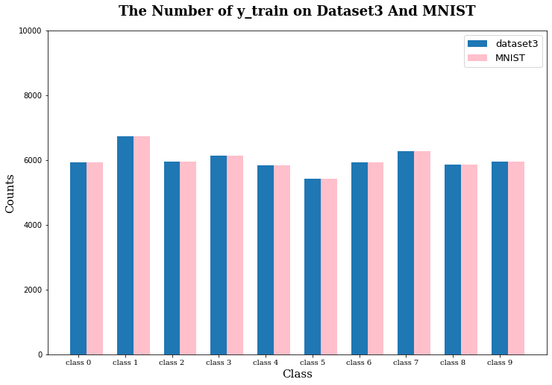
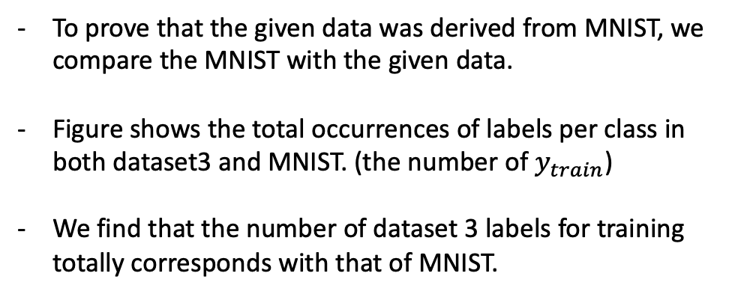
Where is it from?
Dataset 3 vs MNIST
‹#›

Slide 24
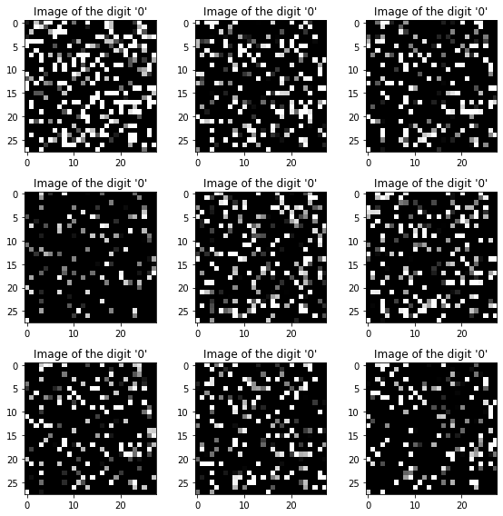
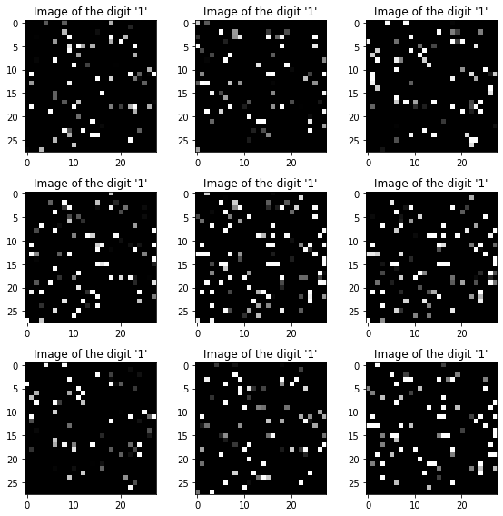
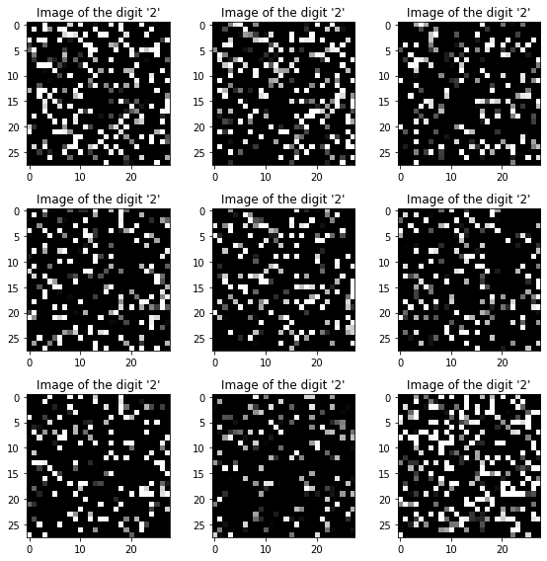
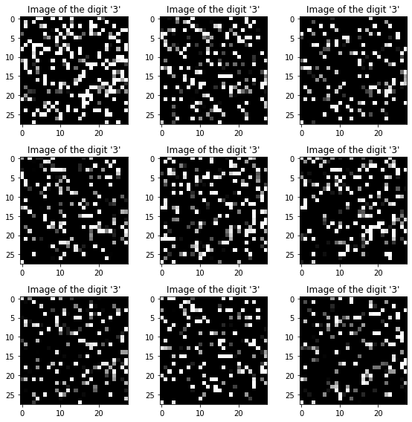
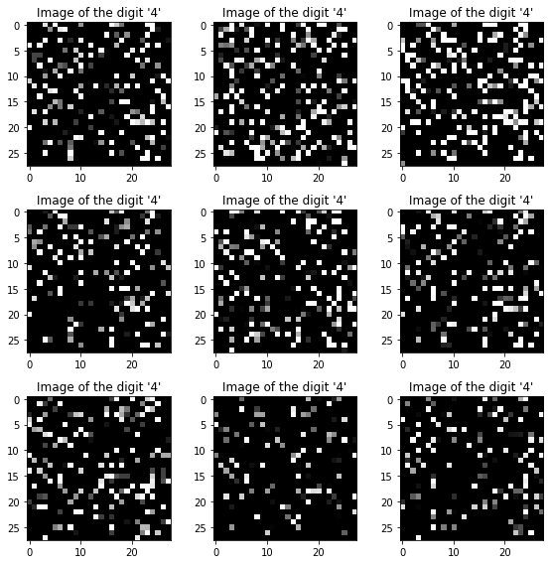
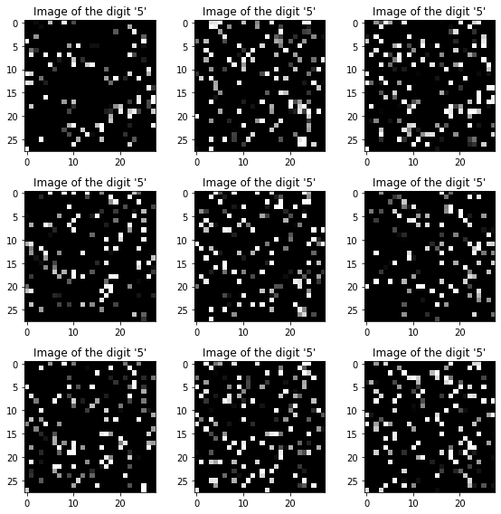
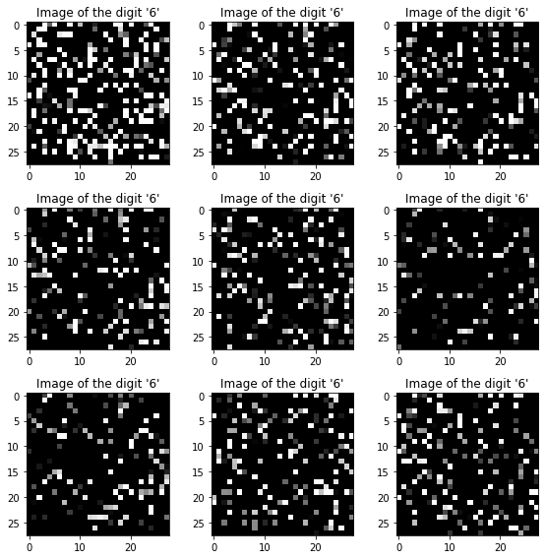
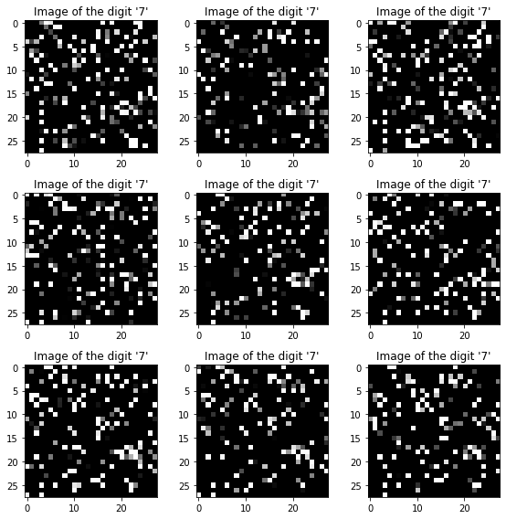
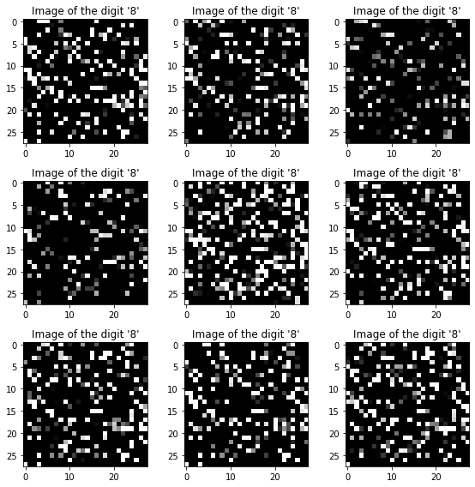
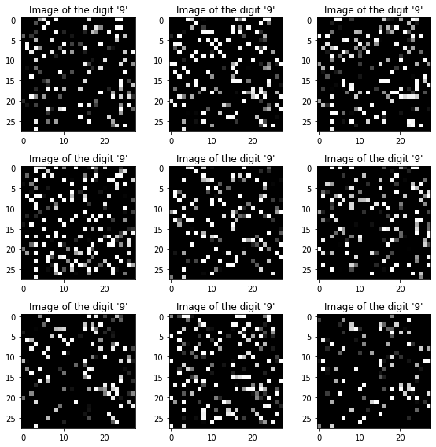
Dataset 3
Our assumption is that dataset 3 was transformed by permutation invariance on MNIST, which is a different random permutation of the input pixels.
0
1
2
3
4
5
6
7
8
9
‹#›

Slide 25
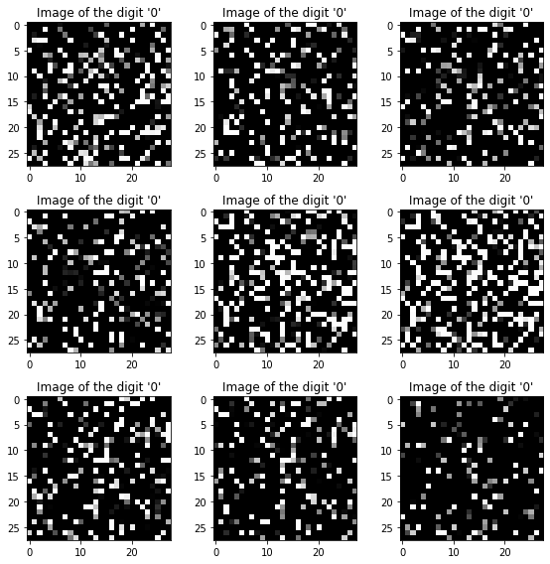
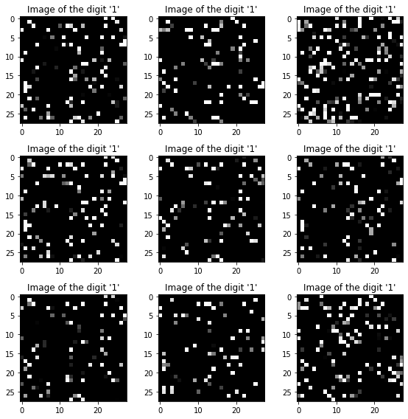
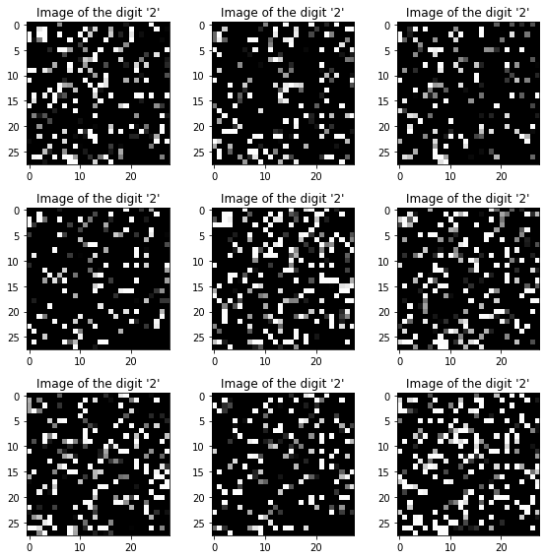
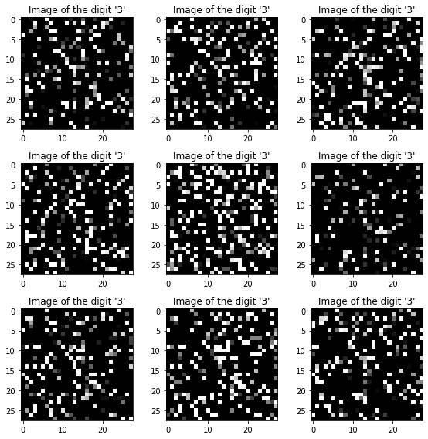
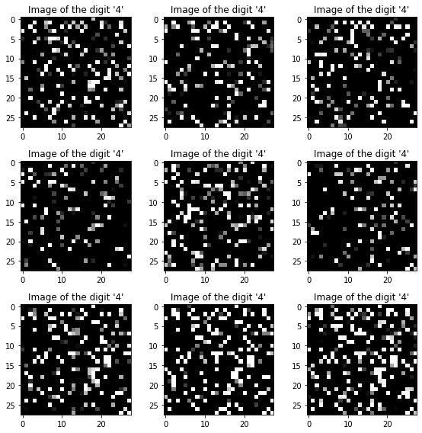
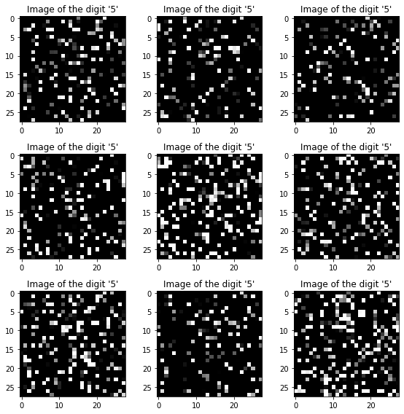
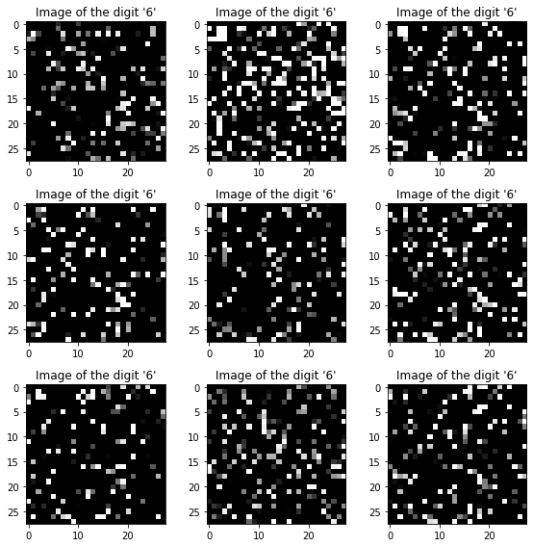
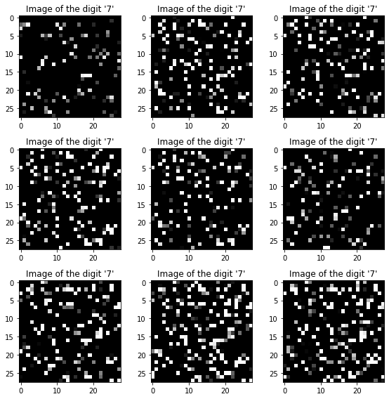
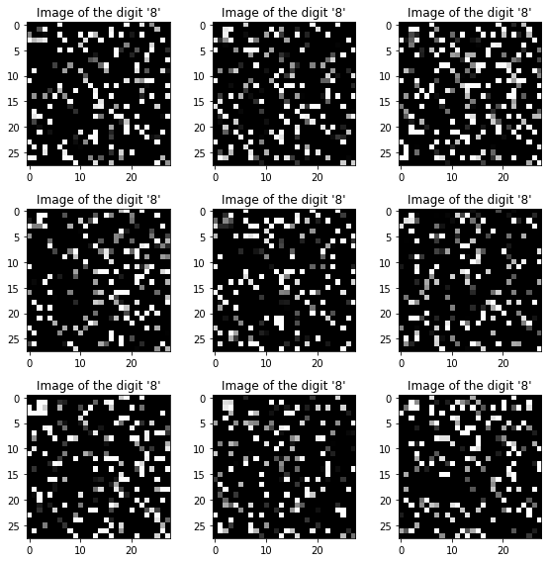
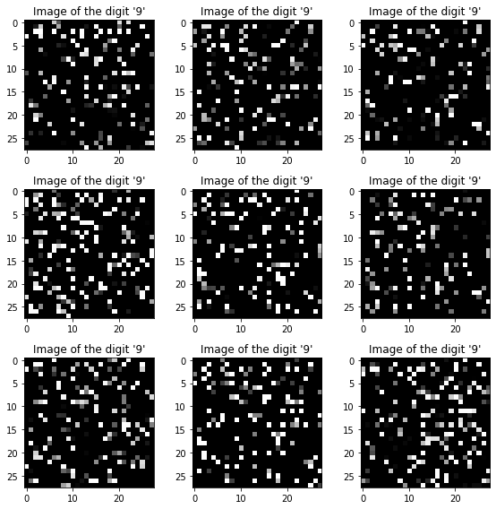
Permuted MNIST
To achieve that assumption, we try to convert MNIST into Permuted MNIST under permutation invariance method.
0
1
2
3
4
5
6
7
8
9
‹#›

Slide 26

Model Architecture & Dataset
There is no reason why to use CNN because the dataset has rarely ‘spatial information’.
We use Fully Connected Neural Network for classification.
For better performance, we augmented the original dataset 3
under permutation invariance.
train: 48,000 🡪 192,000
valid: 12,000 🡪 48,000
test: 60,000 🡪 60,000
Adam optimizer (B1 = 0.9 & B2 = 0.999)
Learning rate: 0.001
Epoch / Batch_size: 100 / 128
‹#›

Slide 27

Result
Accuracy 98.37
‹#›

Slide 28
Dataset 4

Slide 29


Assumption
Structured, or Unstructured That is the question.
Text data
‹#›

Slide 30


Assumption
Structured, or Unstructured That is the question.
Image data
‹#›

Slide 31

Assumption
Structured, or Unstructured That is the question.
Time series
‹#›

Slide 32

Assumption
Structured, or Unstructured That is the question.
Tabular data
First five rows of train and test data
‹#›

Slide 33

Modeling
Look before you build your model
Class label imbalance?
‹#›

Slide 34

Modeling
Look before you build your model
Highly Correlated Features?
Orange dots represent “abs(corr)>= 0.3”
‹#›

Slide 35

Modeling
Look before you build your model
Extreme Outlier?
‹#›

Slide 36

Modeling
Look before you build your model
Missing values?
‹#›

Slide 37


Modeling
Look before you build your model
Pipeline !
‹#›

Slide 38


Result
Don't count your chickens before they hatch
LDA to QDA
LDA & QDA based ensemble model
‹#›

Slide 39


Result
Don't count your chickens before they hatch
Flexible Decision Boundary
‹#›

Slide 40


Result
Don't count your chickens before they hatch
Bang! Bullseye!
‹#›

Slide 41
Dataset 5

Slide 42

Data Description
Data shape
Label Ratio
‹#›

Slide 43


What is this data?
‹#›

Slide 44
What is this data?
‹#›

Slide 45

Image?
‹#›

Slide 46

Image?
‹#›

Slide 47
Train with a well pre-trained model
Class 1
Class 2
Class 3
Class 4
Class 5
Input image
Pretrained model
Replaced Layer
‹#›

Slide 48

EfficientNet
‹#›
Tan, Mingxing, and Quoc Le. "Efficientnet: Rethinking model scaling for convolutional neural networks." International conference on machine learning. PMLR, 2019.

Slide 49

Scale the image
10 X 10 🡪 32 X 32
INTER_NEAREST – a nearest neighbor interpolation
INTER_LINEAR – a bilinear interpolation
INTER_AREA – resampling using pixel area relation
INTER_CUBIC – a bicubic interpolation over 4 X 4 neighborhood
INTER_LANCZOS4 – a Lanczos interpolation over 8 X 8 pixel neighborhood
‹#›

Slide 50


Summary
10 X 10 image
32 X 32 image
Resize using Interpolation
EfficientNet
‹#›

Slide 51

Result
EfficientNetB1
Batch size – 32
Learning rate – 0.0001
Optimizer – Adam
Interpolation – INTER_LINEAR
‹#›

